Slide 1
Workflow Orchestrator Suite
Prefect with Python
Workflow Engine
Interactive No-Code DAG
Log Centralisation
Serialized Object Storage
ElasticSearch on Logs
Version controlled Containerization
Seamless development focus

Slide 2

Challenges Faced
Slow Development
Pace of development is hindered due to excessive infrastructure overhead
Scalable Principles
Lack of planning for scalability right from the first iterations of development
Debug and Testing
Complicated routes and principles for debug and testing implemented by individuals
Strong Foundations
Lack of methodical structuring in the low level design of services

Slide 3

Task Orchestration
Efficient management and coordination of tasks within workflows, no-code support for creation of DAG without codebase refactoring
Scheduling and Monitoring
Minimal Effort Scheduling of tasks and workflow and tools to monitor and analyze job flows
Version controlled Containers
Less hindrance on development of services due to automated version controlled tracking of containers and flow
Logging and Search
Centralised framework for collection, storage and querying of logs as well as support to store serializable objects aiming at greater dev productivity
Key Features

Slide 4
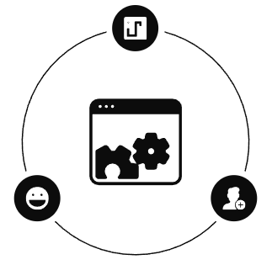
Workflow Automation with Prefect and Python
Prefect and Python Synergy
Perfect tool for python based workflow designs
Seamless onboarding for Python Codebases
High Degree of Modularity for feature Integration
Integration of Java Services in Workflow
Productivity and Developer’s Experience
Easy Testing Environment and production services resulting in faster feasibility analysis
Free from relying members to maintain or monkey patch services in development
High Degree of control on Workflow without much knowledge overhead
Automation, Resilience and Adaptability
Strong foundation and Workflow Structure in Dev
Enforces principles of resilience and modularity
High Adaptability achieved through isolation and control measures targeting developers experience
Greater Supervision on dev trails and component analysis

Slide 5
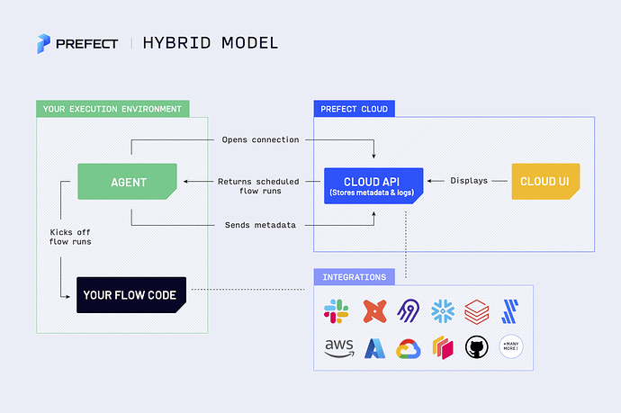
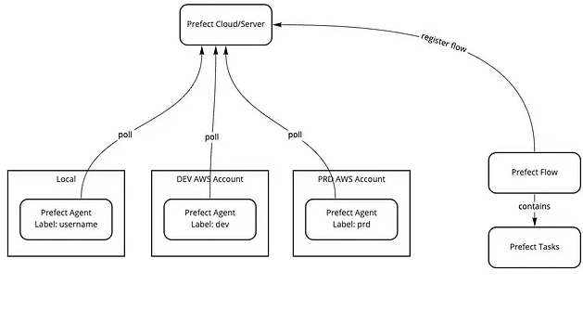
Prefect Design and Usage

Slide 6
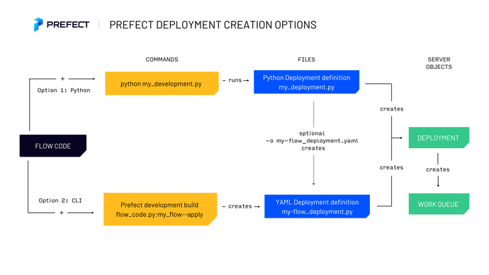
Prefect Job Execution

Slide 7
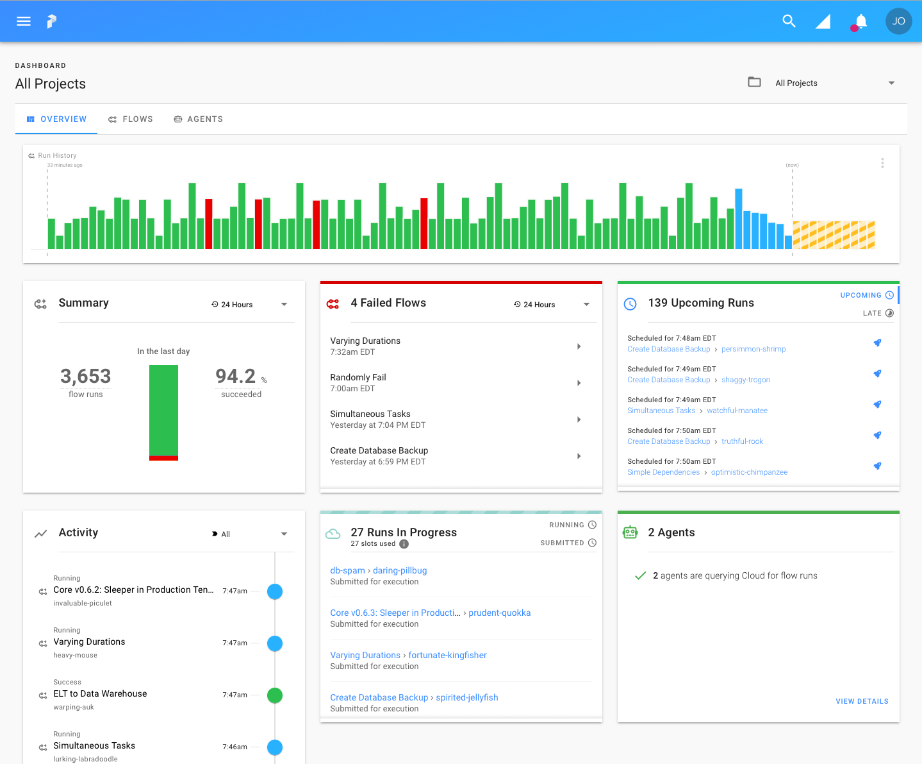
Flow monitoring
Agent logs
Deployment scheduling
Basic Analytics on Flows
Activity History
Version control and Repo Integration
Container level summary and logs
WorkFlow Dashboard

Slide 8
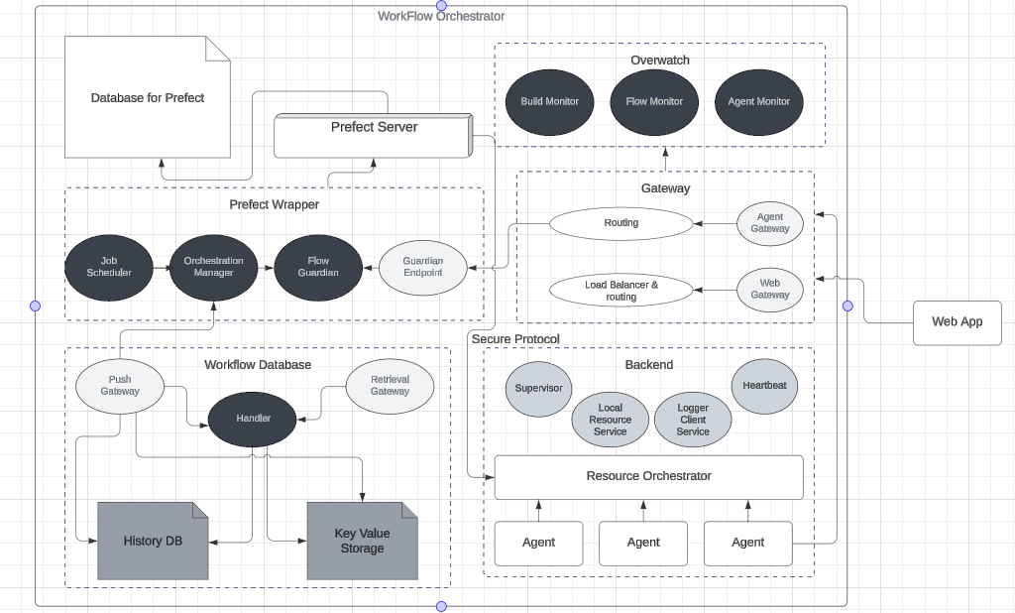
WorkFlow Orchestrator Design

Slide 9
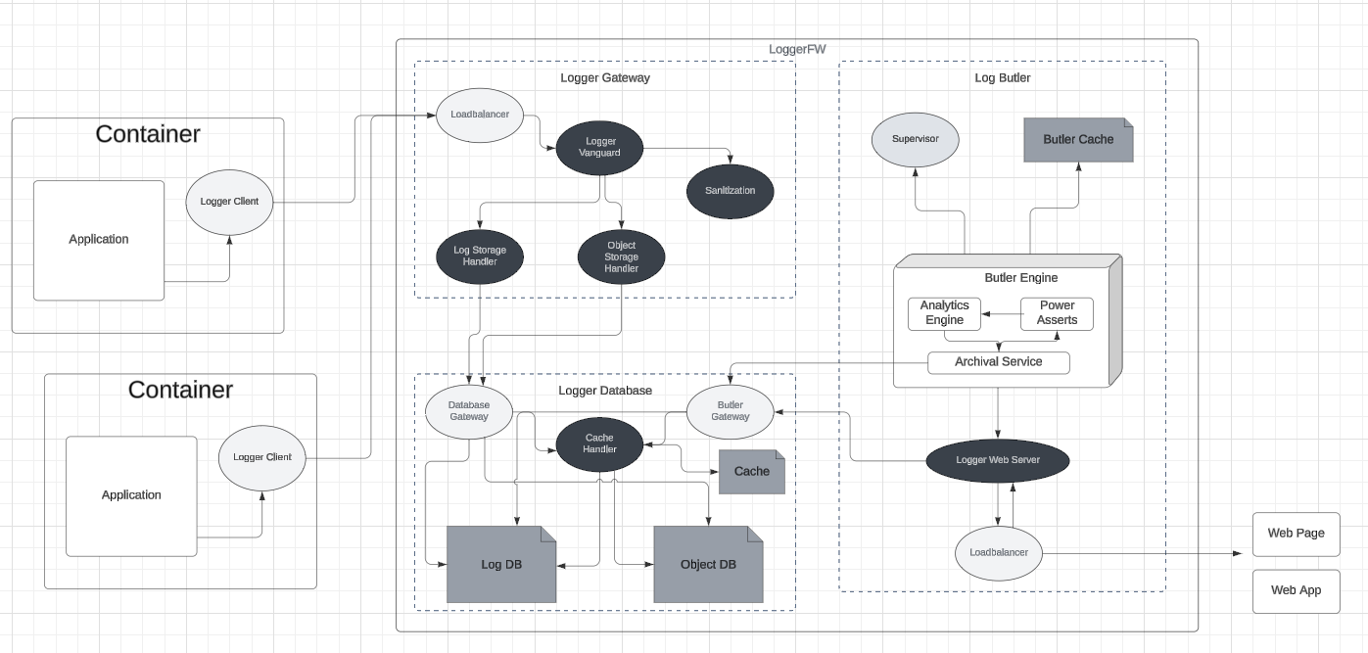
Logger FrameWork

Slide 10
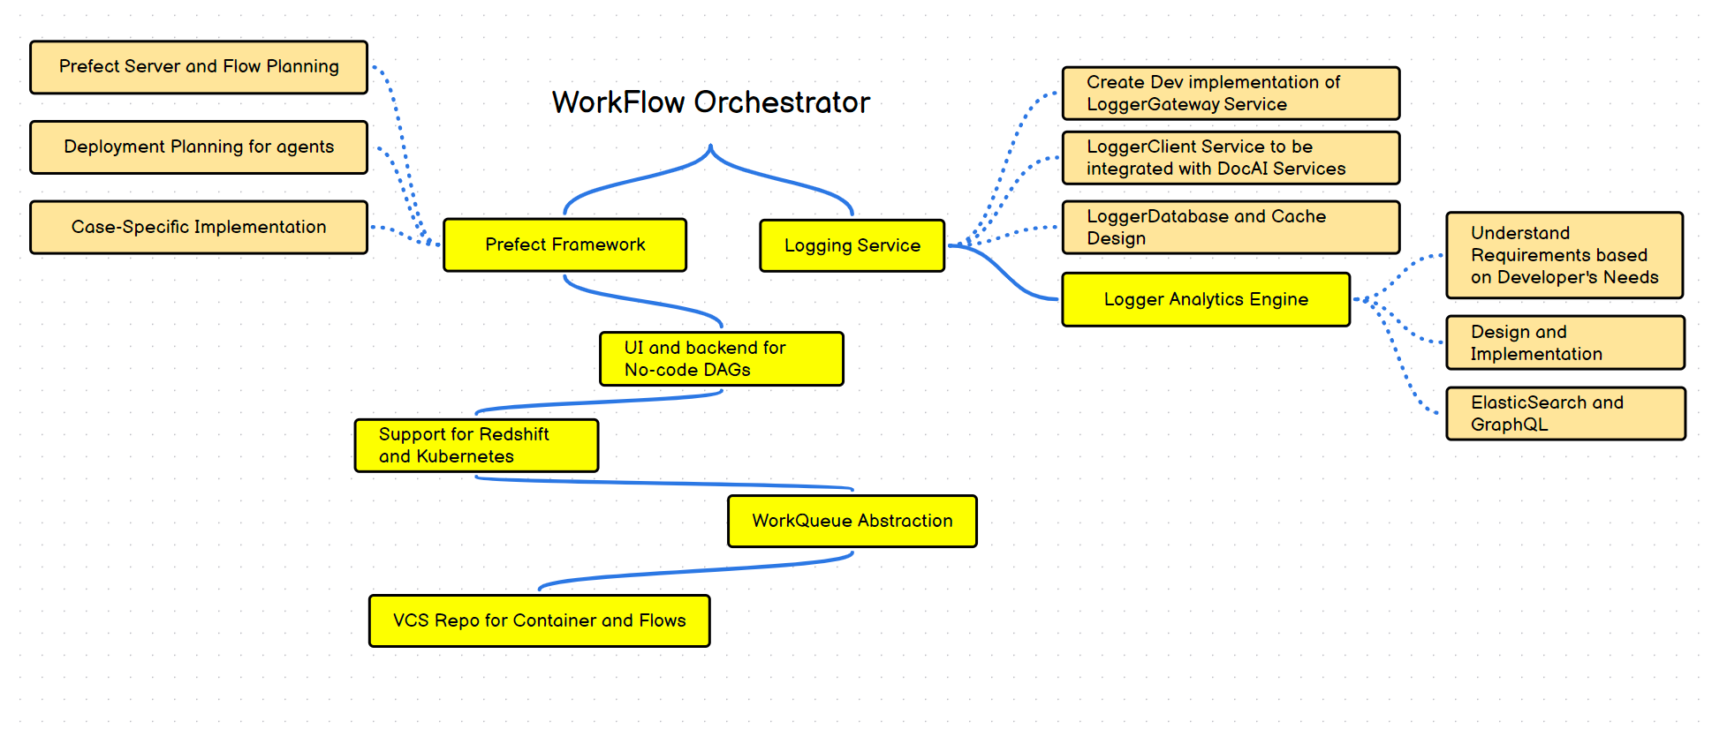
Roadmap

